Slide 1




prioritizr Systematic conservation planning in R R
Jeffrey Hanson
jeffrey.hanson@uqconnect.edu.au
prioritizr.github.io/prioritizr

Slide 2


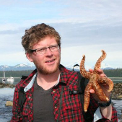
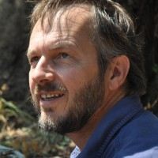

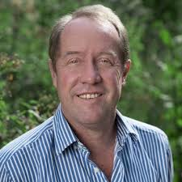
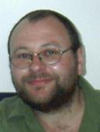
Acknowledgements
Richard Schuster
Matt Strimas-Mackey
Nina Morrell
Matt Watts
Joe Bennett
Peter Arcese
Hugh Possingham

Slide 3
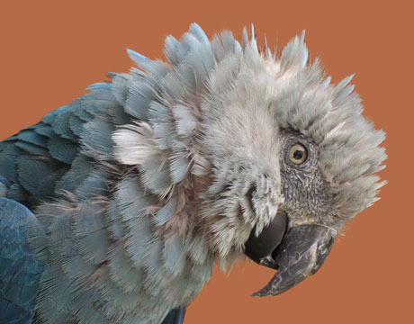
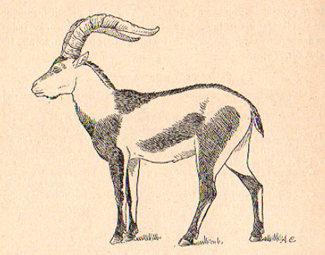

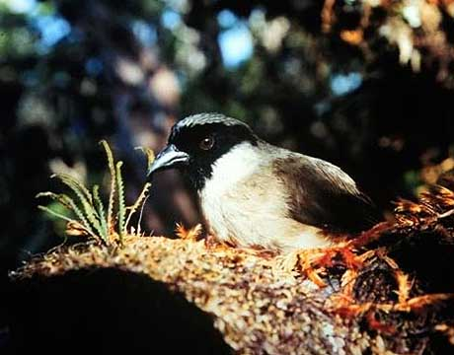
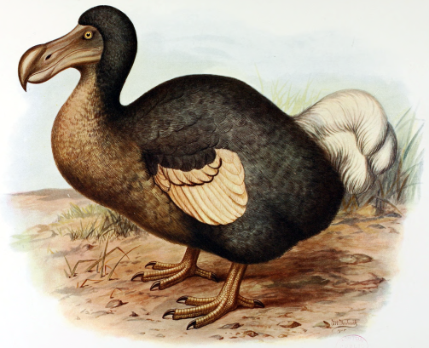
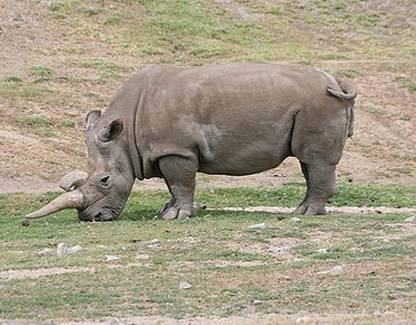
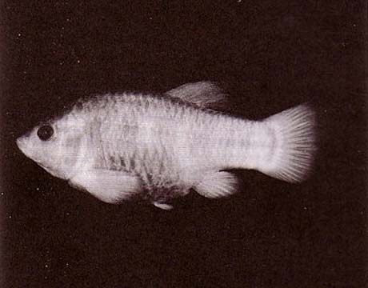
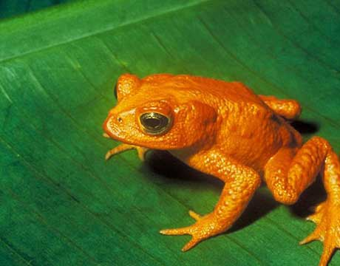
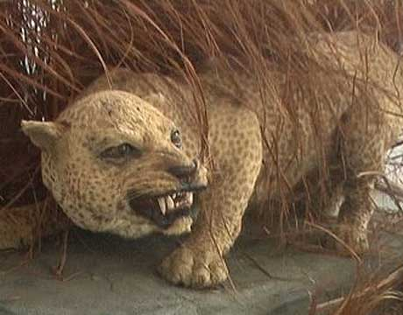
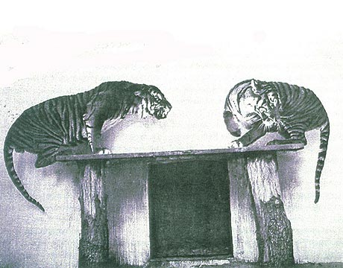
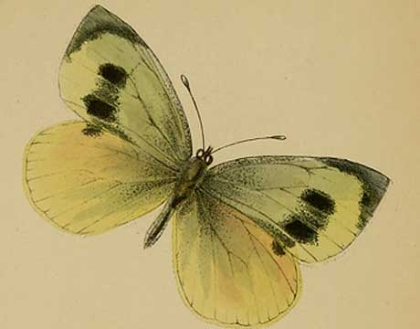
Global biodiversity crisis
Notes:
- high extinction rate
- conservation aims to maintain existing patterns of biodiversity and the processes that sustain them
- areas set aside to preserve biodiversity, and spearhead direct management actions

Slide 4
How should we
manage areas to
achieve conservation?

Slide 5
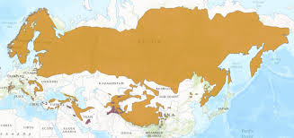
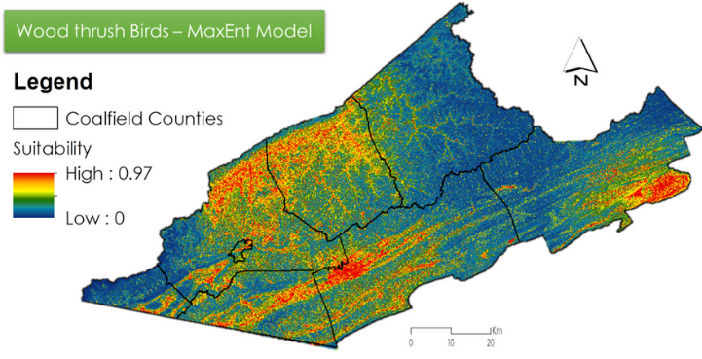
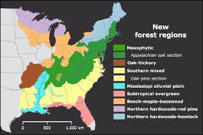
Data
Biodiversity data
Economic data
Other data?

Slide 6


Objective
Minimize cost

Slide 7

Objective
Maximize benefit

Slide 8
Objective
Maximize benefit

Slide 9
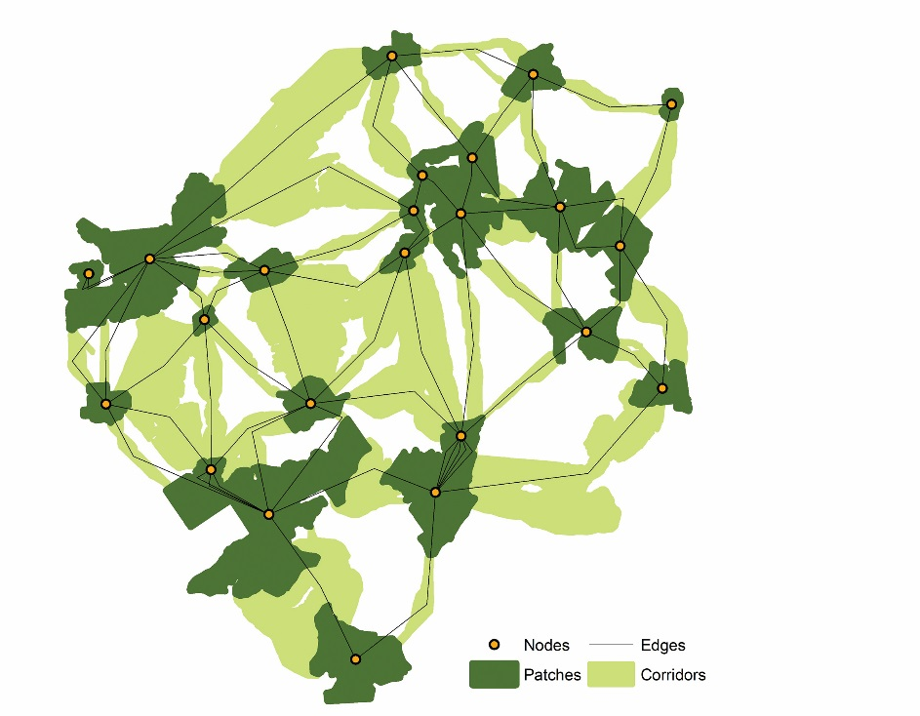
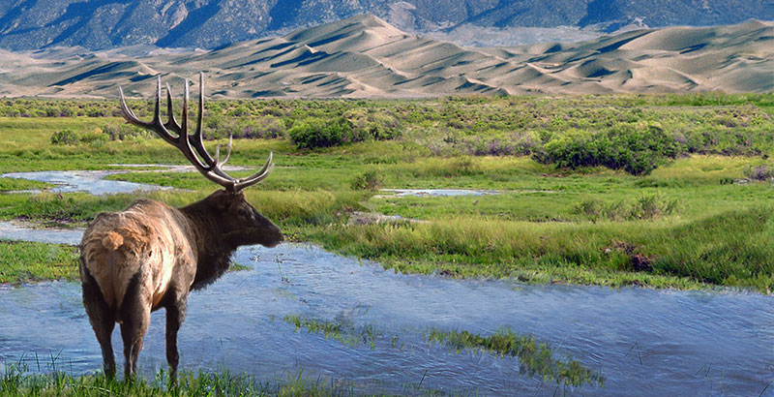
Constraints & Penalties

Slide 10
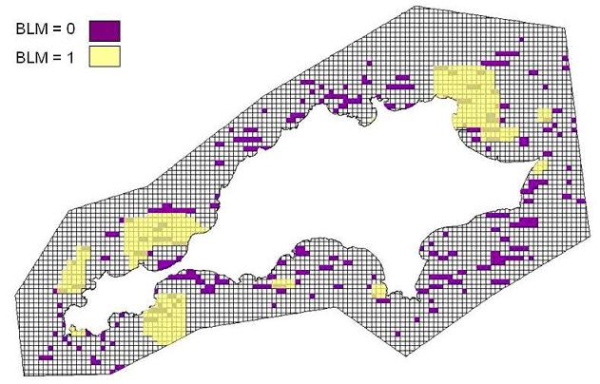
Constraints & Penalties

Slide 11
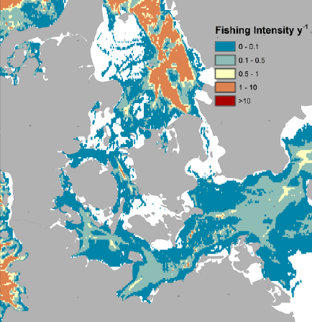
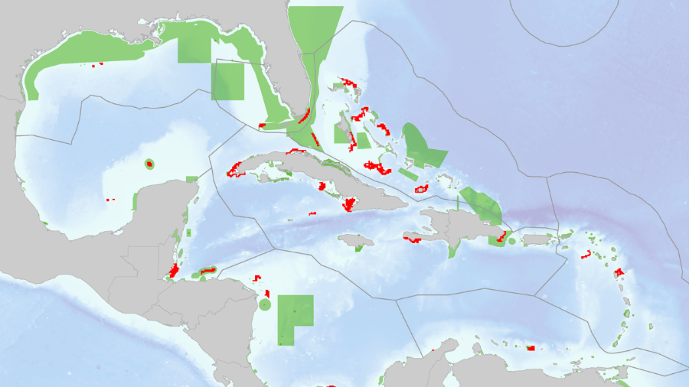
Constraints & Penalties

Slide 12
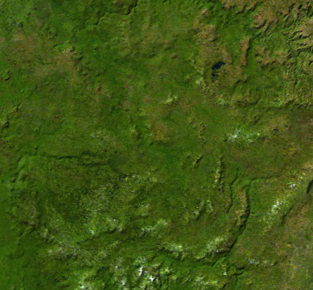
Decision type
Conserve or not?
Conserve a proportion?
Multiple actions?

Slide 13





Solver
?
?
?
?

Slide 14

prioritizr

Slide 15
Define your problem
Mental model
problem <- data +
objective +
constraints +
penalties +
decision type +
solver
solution <- solve(problem)

Slide 16
Define your problem
Mental model
Code
problem <- data +
objective +
constraints +
penalties +
decision type +
solver
solution <- solve(problem)
p <- problem(units, spp) %>%
add_min_set_objective(10) %>%
add_relative_targets(0.1) %>%
add_boundary_penalties(5) %>%
add_binary_decisions() %>%
add_rsymphony_solver()
solution <- solve(p)

Slide 17
Define your problem
Mental model
Code
problem <- data +
objective +
constraints +
penalties +
decision type +
solver
solution <- solve(problem)
p <- problem(units, spp) %>%
add_min_set_objective(10) %>%
add_relative_targets(0.1) %>%
add_boundary_penalties(5) %>%
add_binary_decisions() %>%
add_gurobi_solver()
solution <- solve(p)

Slide 18
Define your problem
Mental model
Code
problem <- data +
objective +
constraints +
penalties +
decision type +
solver
solution <- solve(problem)
p <- problem(units, spp) %>%
add_max_phylo_objective(10) %>%
add_relative_targets(0.1) %>%
add_boundary_penalties(5) %>%
add_binary_decisions() %>%
add_gurobi_solver()
solution <- solve(p)

Slide 19
Define your problem
Mental model
Code
problem <- data +
objective +
constraints +
penalties +
decision type +
solver
solution <- solve(problem)
p <- problem(units, spp) %>%
add_max_phylo_objective(10) %>%
add_relative_targets(0.1) %>%
add_binary_decisions() %>%
add_gurobi_solver()
solution <- solve(p)

Slide 20
Define your problem
Mental model
Code
problem <- data +
objective +
constraints +
penalties +
decision type +
solver
solution <- solve(problem)
p <- problem(units, spp) %>%
add_max_phylo_objective(10) %>%
add_relative_targets(0.1) %>%
add_proportion_decisions() %>%
add_gurobi_solver()
solution <- solve(p)

Slide 21
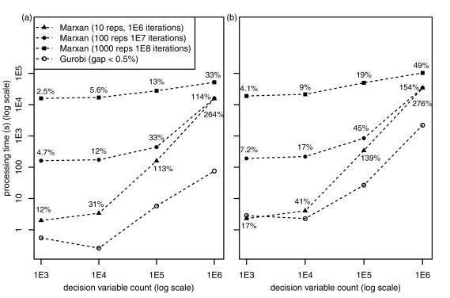
And solve it fast!

Slide 22
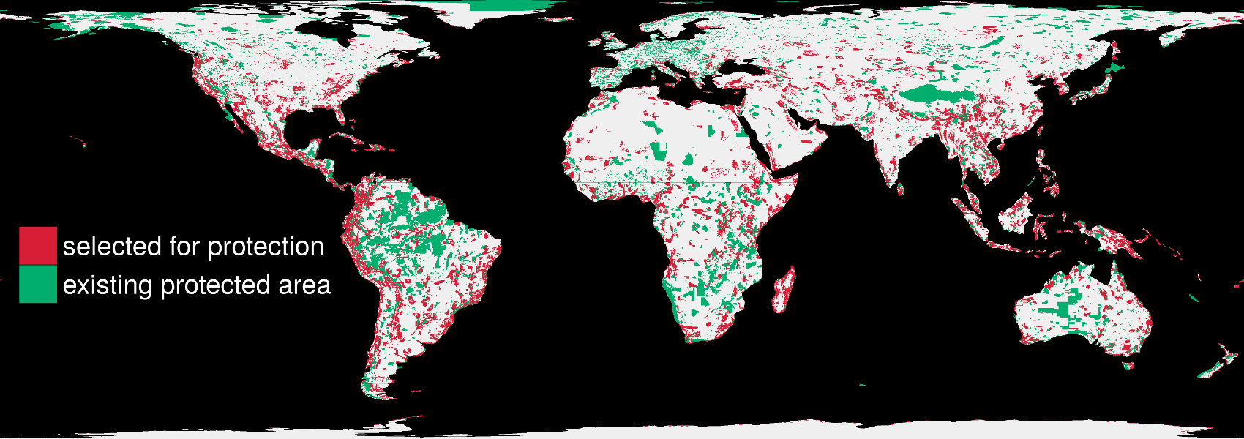
And solve it fast!
1.5 million planning units & 22,644 species: 76 minutes

Slide 23
Case-study

Slide 24
Case-study

Slide 25
Case-study

Slide 26
Case-study

Slide 27
Case-study

Slide 28
Future work
Point-and-click interface (prioritizrshiny)
Multiple types of actions (e.g. MarZone)
More objectives, constraints, and penalties!

Slide 29



jeffrey.hanson@uqconnect.edu.au
github.com/prioritizr/prioritizr
prioritizr.github.io/prioritizr

